Slide 1
CS 205
Artificial Intelligence

Slide 2
You Tell me: In this class you hope to learn ...[ ? ]...
Please raise your hand so I can unmute you.
This is where you get to talk... so don't be shy.

Slide 3
Syllabus
Textbook
Assignments
Projects
Exams
COVID-19 Accommodations
Lectures will be recorded and posted
Academic Integrity
if exists y suchThat for x in [employer, family, friends]: if findsOut(x, y) and wouldBeEmbarrassedBy(y): dontDo(y)
Most cheating is an act of desperation. What is a better alternative act to follow?

Slide 4
Cheating
Anyone caught cheating, a cheater, will immediately be assigned an F for the course. No exceptions. They will also be reported.
Anyone enabling a cheater, deliberately or negligently, or who provides inappropriate help is also a cheater. See rule above.
When in doubt: ask the professor first.
Again, your first instinct in desperation may be the wrong one. So your second instinct should be to ask the professor to help you. Courage. It takes courage to ask for help. Be courageous! Cheaters are cowards.

Slide 5
Attendance and Active Participation
Attendance is compulsory and earns only partial credit toward your active participation.
Active participation requires you, for example, to raise your hand, ask and answer questions, provide useful information to others, post related articles for others to read, engage with your classmates on the reading material, and to otherwise contribute to a vibrant learning environment.

Slide 6
Zoom
Zoomboming — don't fan the flames
You tell me... have you experienced zoombombing?
Chatting
Active Participation
raising your hand
polls
Basic Etiquette
You tell me... what do you think are the rules of etiquette?

Slide 7
Slack
Channels
#general — 99.9% of course discussion goes here
#random — unrelated stuff goes here
#notes — slides, recordings and other materials will be posted here
Requirements — use official UCR identifying credentials else get booted
Basic Etiquette
You tell me... what do you think are the rules of etiquette?

Slide 8
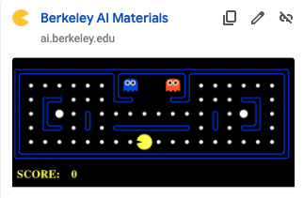
Main Project — PacMan Search
Details will be posted soon
Work in small teams (up to 3; not more than 3; less than 4; 1 or 2 or 3)
Start looking if you want: http://ai.berkeley.edu/project_overview.html
Optional Tasks:
Capture the Flag
Reinforcement Learning

Slide 9
Project #2 (of your choosing)
Usually: machine learning.
Also, small teams.
Details will come later.

Slide 10
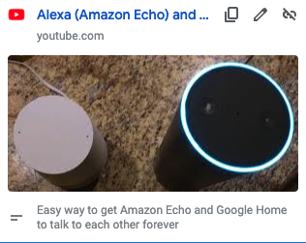
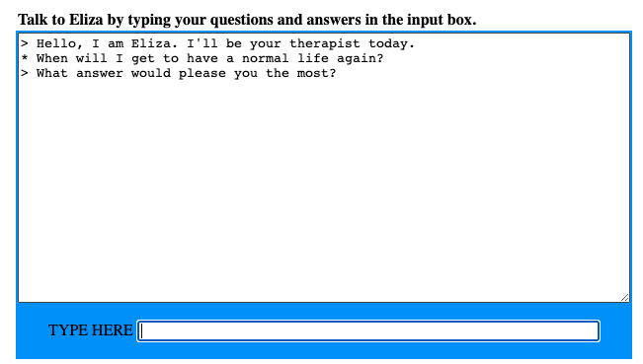
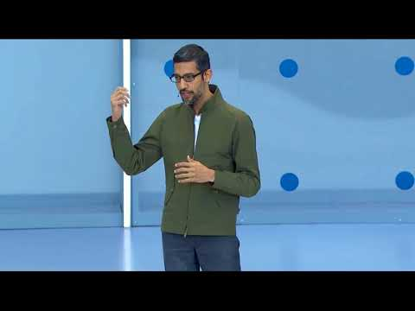

What is AI?
https://www.youtube.com/watch?v=LEz9AU9c2qQ
Watch this:
https://web.njit.edu/~ronkowit/eliza.html

Slide 11
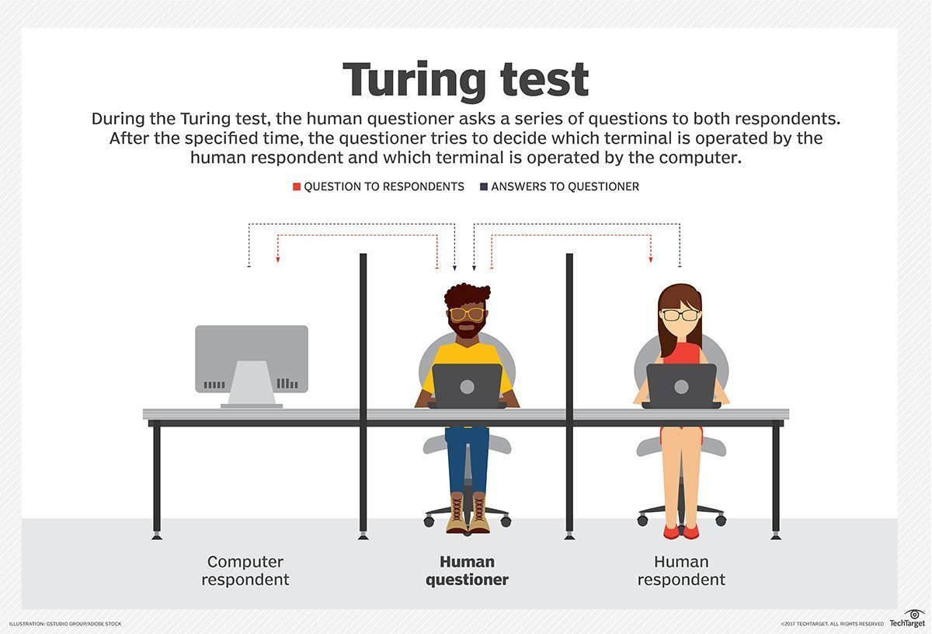
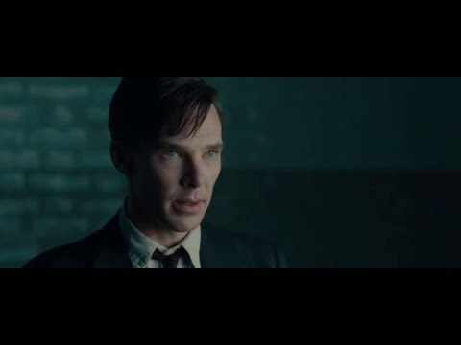
What is AI?
The Turing Test
Questioner
Human Respondent
Computer Respondent
Can the questioner tell them apart?

Slide 12
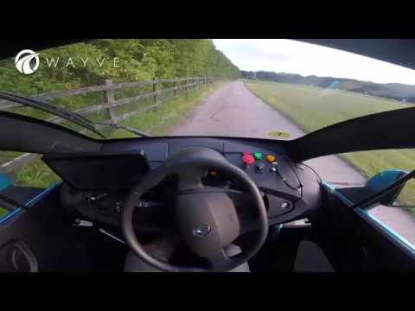
What is AI?
Machine Learning
Robotics
.... vision, language, knowledge, perception, actuators ....

Slide 13
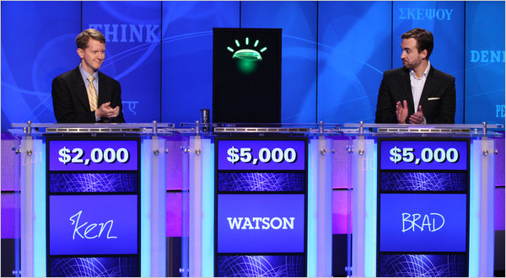
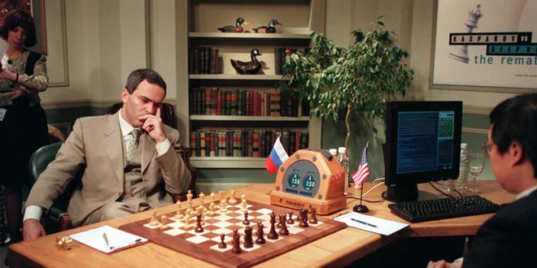
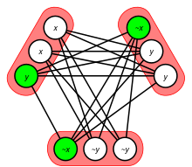
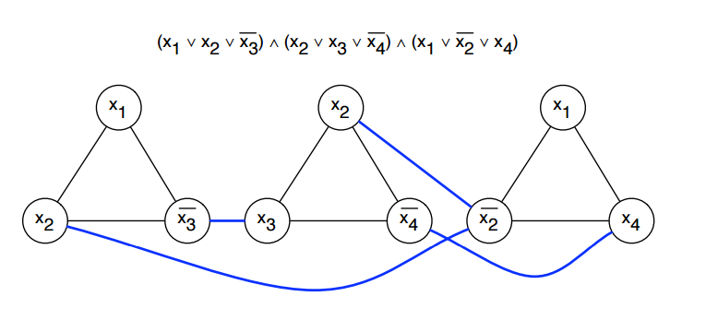
What is AI?
2010 IBM Watson beats best Jeopardy players
1997 IBM Deep Blue wins at Chess
Wait, is Satisfiability an AI problem?

Slide 14
What is AI?
You tell me: what else is AI?

Slide 15
Why Study AI?
... let's take a look at some other very useful slides ...

